Slide 1

Binary Search Trees Analysis
Ido Begun, Yael Golan & Idan Shabat

Slide 2

Binary Search Trees
A common database, used for storing data with comparable elements
Integers, strings etc.
Abbr. BST
For each node with value d:
If a node in the left subtree has value d’: d’ ≤ d
If a node in the right subtree has value d’: d ≤ d’
6
2
6
-1
5
10

Slide 3
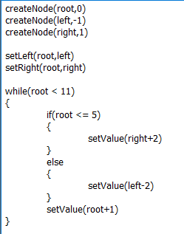
BST Programs
Programs that uses BSTs should keep them valid, while supporting operations like:
Insertions
Setting values
Setting children
Goal: given such program, verify that all of the BSTs created in it remain valid (at the end of the run, or at a certain interior point).

Slide 4
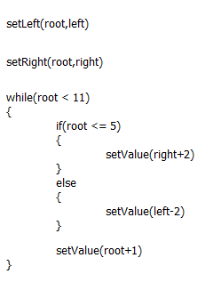
The CFG Algorithm
Create the CFG of the program

Slide 5
The CFG Algorithm
Initialize all the CFG nodes with the empty abstract state
ε
ε
ε
ε
ε
ε
ε
ε
ε
ε

Slide 6
The CFG Algorithm
Choose an arbitrary node and update it:
For nodes after if or else: State = Previous State П Boolean Statement, or State = Previous State П !(Boolean Statement)
For nodes after if blocks, and before while: State = Previous States
For nodes after skip: State = Previous State
For nodes after other commands: State = [command]#(Previous State)
Continue with process, until a fix point is reached, or until we had enough iterations
П

Slide 7
Assumptions on the Program
The values of the BST nodes are integers
The following commands are supported:
createNode(n,d) – creates a new node with value d.
setLeft(n,n’) – sets the left child of n to be n’.
setRight(n,n’) – sets the right child of n to be n’.
setValue(n,d) – sets the value of n to be d.
setValue(n+d) – increments the value of n by d.
setValue(n-d) – decrements the value of n by d.
The programs use the commands properly
There is no createNode(n,d) if n is already created.
There is no setLeft(n,n’) or setRight(n,n’) if n already has a left or right child, respectively.
All nodes names inside the set-commands should exist.

Slide 8
Concrete States Lattice
N denotes the set of nodes in the program
N⁺ = N ᴜ {null}
A concrete state is a finite set of partial functions s: N → N⁺× Z × N⁺
If s(n) = (n_{l} , d , n_{r}), then s(n_{l}) and s(n_{r}) are defined.
Partial order:
Join: , Meet:
Bottom: ø
Top: T - A special additional element
Ul
U
U

Slide 9
BST-strings
A BST-string is made of matched parentheses, and represents a BST:
Join (of BST-strings): V =
(r₁ n₀[d₁-d₂] r₂) v (r’₁ n₀[d’₁-d’₂] r’₂) = (r₁vr’₁ n₀[min{d₁,d’₁}-max{d₂,d’₂}] r₂vr’₂)
n₀
4-5
((n₁[0-2]) n₀[4-5](n₂[6-6]))
n₁
n₂
0-2
6-6
n₀
n₀
n₀
4-4
4-5
4-5
n₁
n₁
n₂
n₁
n₂
0-1
2-2
6-6
0-2
6-6

Slide 10
BST-strings
And what if there are different nodes in the same location in the trees? V =
n_{τ} is a “general node” – may represent each node in N.
For two BST-strings w₁,w₂: w₁≤w₂ ↔ w₂=w₁ V w₂
Meet is defined analogously
meet of two different nodes = the empty string
n₀
n₀
n₀
4-4
4-5
4-5
n₁
n₃
n₂
n_{τ}
n₂
0-1
2-2
6-6
0-2
6-6

Slide 11

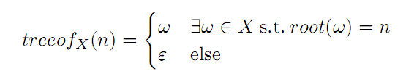
Abstract States Lattice
An abstract state is a set of BST-strings
Different BST-strings don’t have the same root
Partial order:
Join:
where:
Meet is defined analogously.
Bottom: ø
Top: τ - A special additional element

